Slide 1
Christchurch Borough Council – 2013/14 Budget
Consultation Meetings
January 2013

Slide 2
Agenda
National Context
Local Impact
Revenue Budget
Action Being Taken
Your Views

Slide 3
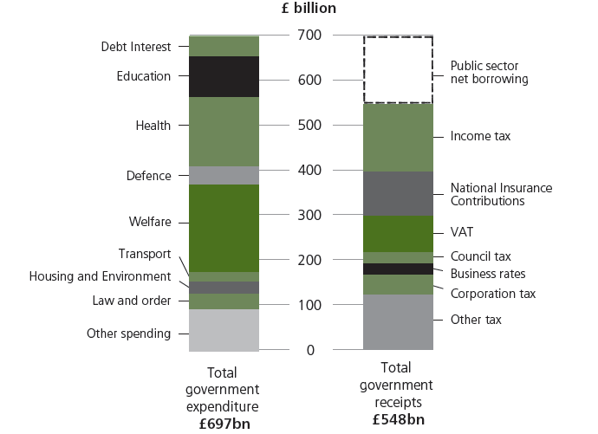
UK Public Sector Spending

Slide 4
UK Government Debt
Here’s the problem - £1 trillion this year

Slide 5
National Pressure

Slide 6
LG National Picture Headlines
Government formula grant down 10% on 2013/14 (£180k), 12% in 2014/15 (£268k)
£5 per household less even by the Gov’t’s figures

Slide 7
Major Changes to Funding Regime
Localisation of Council Tax Support - £6m funding loss across Dorset
Retention of Business Rates – Risk and Reward

Slide 8
Council Tax
No increase in last two years
1% Council Tax freeze grant offered for 13/14 (CBC £33k)
2% cap on 13/14 Council Tax increase (£3.50 pa)
Members considering options

Slide 9
Council Tax Freeze Grant
 | Year 1 | Year 2 | Year 3 | Year 4
B/f Council Tax Billed | £6.5m | £6.5m | £6.5m | £6.565m
1% freeze grant (2 year) | £0.065m | £0.13m | £0.065m
Freeze grant loss |  |  | (£0.065m) | (£0.065m)
1% Ctax increase |  |  | £0.065m | £0.066m
Total Income | £6.565m | £6.63m | £6.565m | £6.566m
B/f Council Tax Billed | £6.5m | £6.565m | £6.63m | £6.70m
1% Ctax increase | £0.065m | £0.066m | £0.066m | £0.067m
Total Council Tax Income | £6.565m | £6.63m | £6.70m | £6.77m

Slide 10
Financial Objectives
Must set a balanced budget
Must have an adequate level of reserves

Slide 11
Revenue Budget
 | Christchurch £m
Gross Expenditure | 35
Gross Income | (29.5)
Net Budget | 5.5
Funded by;
Formula Grant (inc Ctax Freeze) | 2.2
Council Tax | 3.3

Slide 12
Balancing the books
The variables
Inflation on expenditure
Salaries and pension fund increases
Income - sustainability and increases
Central Government funding reductions
Funding regime changes
Council tax increases/freeze grant
Contribution to or from reserves
Growth
Local priorities

Slide 13
Reserves
 | CBC £000s 11/12 | CBC £000s 12/13
Earmarked | 2,868 | 1,592
General Fund | 2,240 | 1,090
Capital Receipts Fund | 1,429 | 1,789

Slide 14
Capital
Current Programme
£9.7m 2012/13 - 2017/18
Rationalisation in 13/14 to £8m

Slide 15
Action Being Taken
Fundamental Budget Reviews
Further sharing/partnerships
Council Tax increase strategy
Fees and charges strategy
Further review of contributions to reserves
Accommodation Strategy
Varying LCTS scheme
VFM/Procurement reviews
Increase New Homes Bonus

Slide 16
Outcome of Actions
Savings from shared services £650k
On target to save £1m
Protecting services
Solid base to face future funding cuts

Slide 17
The Message
The Council is saving money
Proactive strategy to manage running costs
Opportunities to invest will be explored

Slide 18
Questions

Slide 19
How do we become more efficient ?
Item | More | Less | Same | Comments
Shared Services
Increase Fees and charges
Outsource services
Rationalise accommodation
Review staff terms and conditions
Local pay discretion
More partnership procurement
Invest to save
Borrow to save
More liberal Planning
Increase Council Tax
Stop some services

